Slide 1
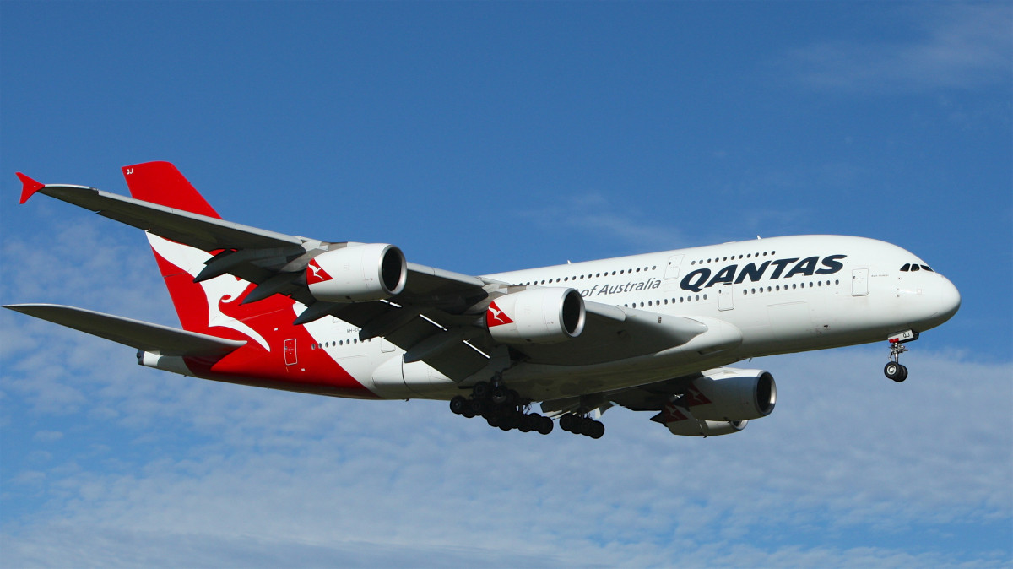
AIRLINE MANAGEMENT SYSTEM

Slide 2
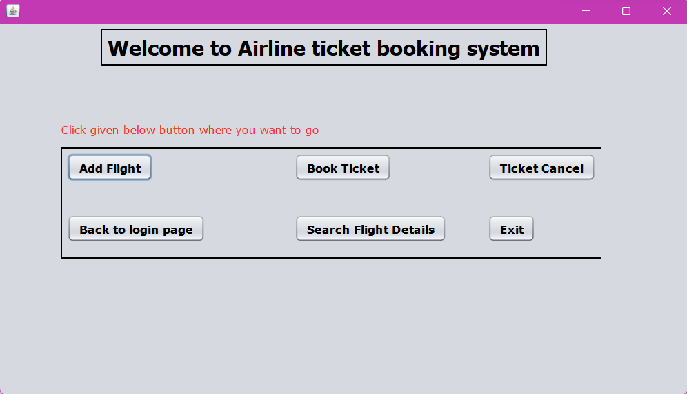
INTRODUCTION
The airline industry has been growing rapidly over the past few years, and with that growth comes the need for more efficient and effective management systems. Our project is aimed at developing an airline management system that will help airlines to manage their operations more effectively and efficiently.
In this JAVA Major project mainly, we are going to concentrate on ticket booking function, this function will take the user inputs like their requirements (flight name, flight source & destination, Number of seats(Seat numbers) and we are going to use java AWT, java swing and java SQL driver(JDBC) for connection to the database

Slide 3
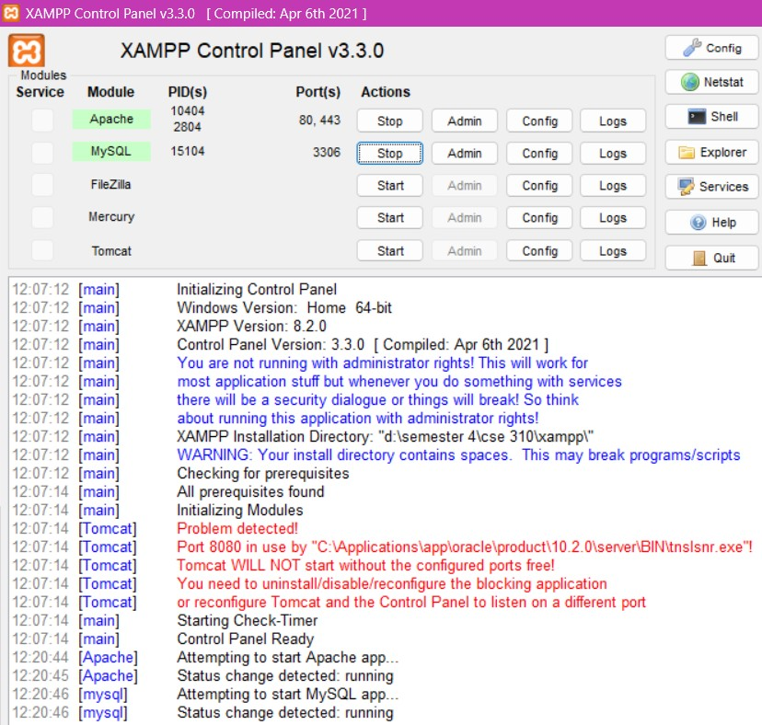
TOLLS USED:
APACHE NETBEANS
Apache NetBeans (previously known as just NetBeans) is an open-source integrated development environment (IDE) for software developers. It provides a range of tools for developing desktop, mobile, and web applications using various programming languages such as Java, PHP, HTML, JavaScript, C++, and more.
XAMPP
XAMPP provides a Control Panel for efficient management of the software in the XAMPP package. We have used the Control Panel to determine whether Apache and MySQL are currently running and also to control to start or stop them. Before we start our project development environment, Apache and MySQL must be running.

Slide 4
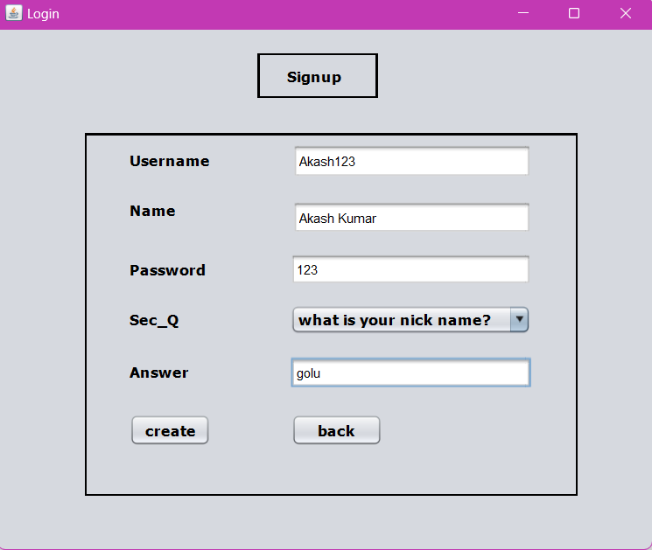
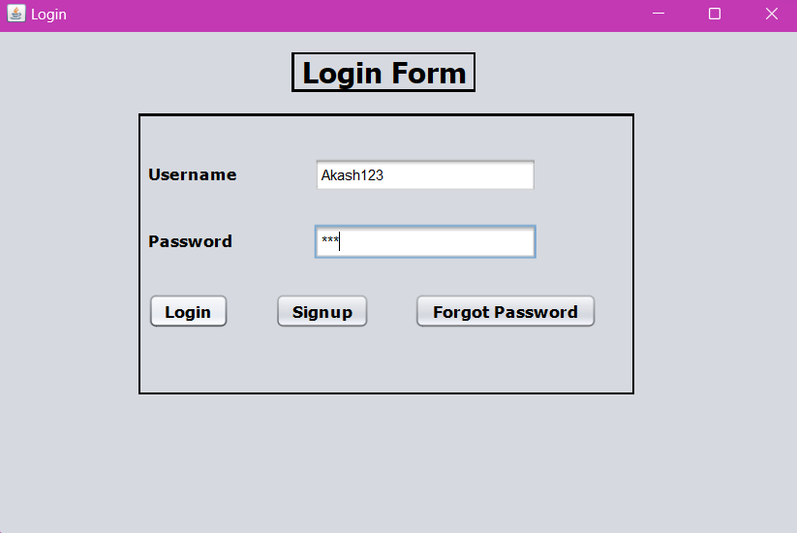
Features
Our airline management system will feature a range of tools and capabilities, including:
LOGIN/REGISTRATION: -
a. Registration: Allow admin/users to create a new account by providing basic information such as Username, and password. This information can be saved in a database to facilitate future logins.
b. Login: Provide a login form that allows users to enter their Username and password to access the system. If the user has forgotten their password, a forgotten password option is also provided.

Slide 5
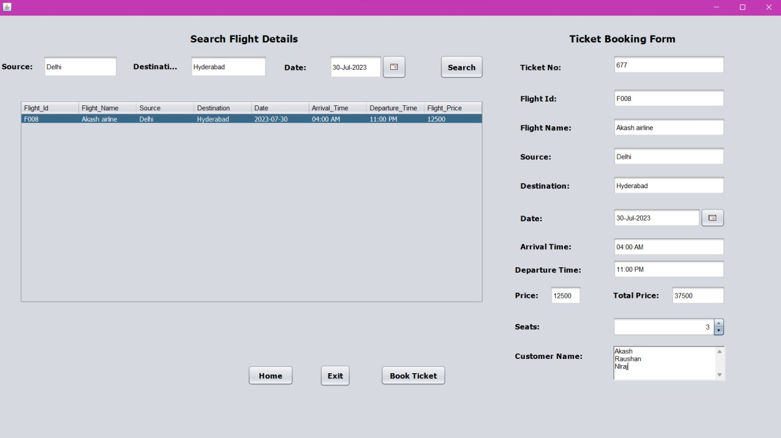
•
Ticket Booking
a. Real-time information: Provide users with up-to-date information on flights, including departure and arrival times, flight numbers and airline information. This can be displayed in a table format with sorting and filtering options.
b. Search: Allow users to search for flights based on their preferences, such as departure and arrival location, dates of travel, and number of passengers/capacity. The class code and class name are also included. This can be done using a search button in the top side of the page with up-to-date information on flights, including departure and arrival times, flight numbers, and airline information. This can be displayed in a table format with sorting and filtering options.
•

Slide 6
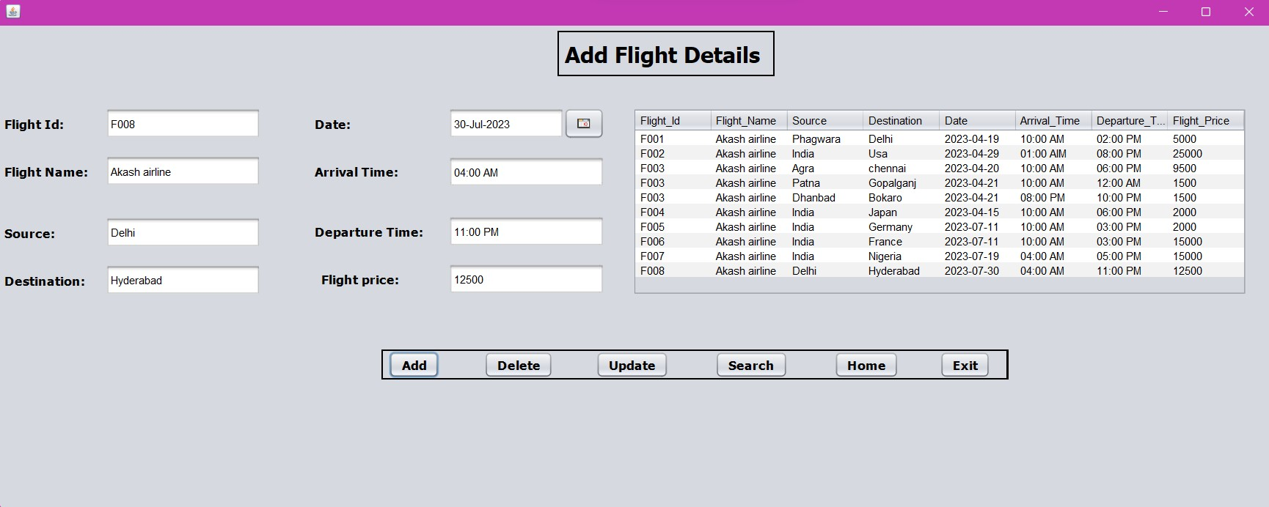
•
Adding flight Details:
a. Personal Information: In this page we provide flight_id, flight_name, source/destination, date, arrival time, departure time and even the price of the flight. The search button will show the flight details.
Editing flight details: In the adding flight details page we can perform add, searched, update, and even delete operation. All the flight details show in the left big cell.

Slide 7
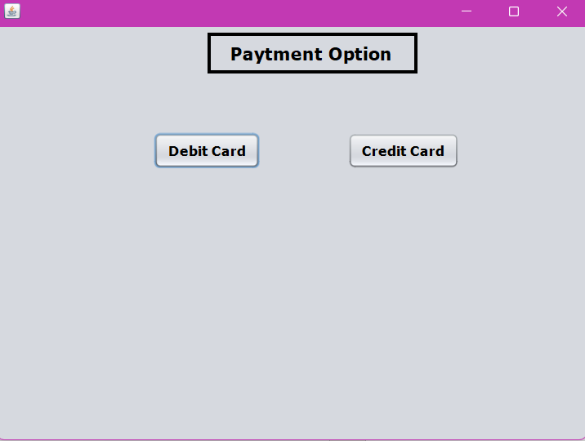
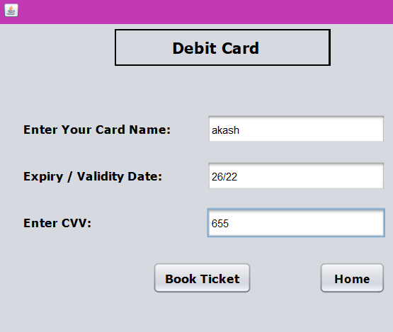
Payment Details:
a. Payment Gateway: Integrate with a payment gateway to allow users to make payments securely using various payment methods. Simply have to insert the name which is mentioned in the card (either debit or credit choice), expiry/validity date and CVV number then the payment is done.

Slide 8
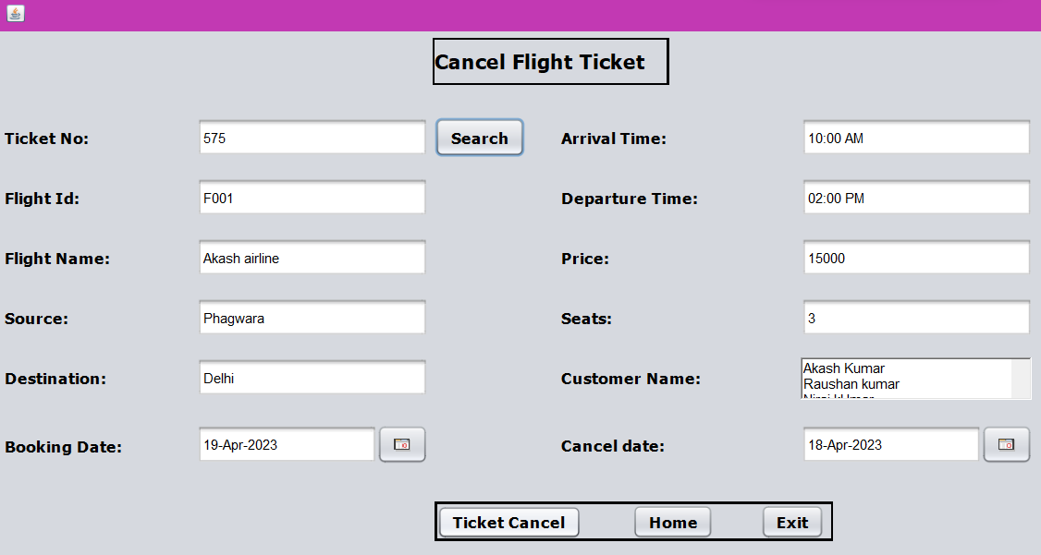
Ticket Cancellation: -
a. Cancellation: This page contains Ticket number, flight id, seats, price and other flight details.
b. Search & Date: only by writing ticket no and clicking on search button, user can see all the details of its flight. User have to select the ticket cancellation date and by clicking on Ticket Cancel, the ticket is cancelled.

Slide 9
Conclusion
Our airline management system is a comprehensive solution for managing airline operations, designed to help airlines to manage their fleets, schedules, reservations, and customer service functions more effectively. We believe that our system will provide significant benefits to airlines, including increased efficiency, improved customer service, and cost savings, and we are confident that it will be a valuable tool for the airline industry in the years to come.

